Slide 1

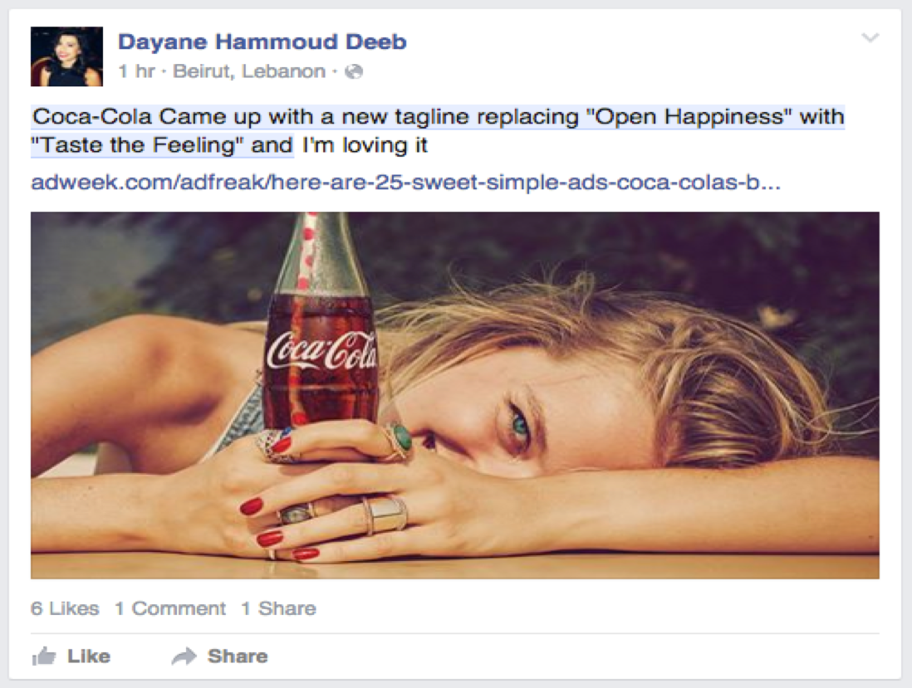
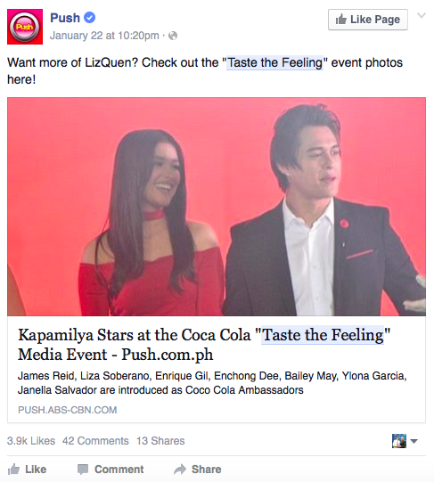
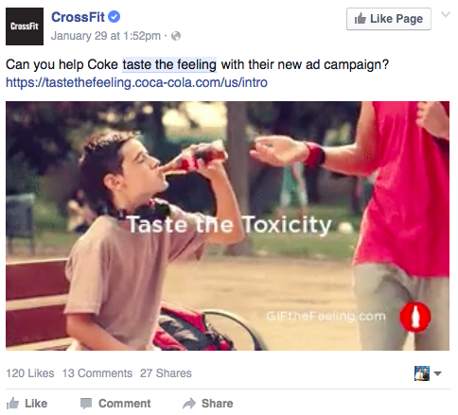
Report 2-1-2016
Taste the Feeling Campaign Results
A | Campaign Flow and Statistics
Insightpool aggregated every Facebook post relative to the “Taste the Feeling” launch from 1/21/16 until 2/1/16 in order to demonstrate the capabilities of Insightpool’s Facebook Topic Data Insights in lieu of a potential long-term partnership with Coca-Cola. Insightpool was able to identify the key drivers of the Taste the Feeling WOM in addition to their demographic make-up as the campaign progressed on the world’s largest source of public opinion, Facebook.
The campaign demonstrated strong engagement throughout its infancy. Countries like Columbia and Philippines over-indexed in terms of volume due to the cult following surrounding their respective celebrity advocates. Advocates and media contributed the largest portions of the word of mouth while GIF authors and opposition drove the WOM roughly the same amount of time.
Media
Advocates
GIF Authors
Opposition
1/19/16-1/21/16
1/22/15-1/25/16
1/25/15-1/26/16
1/26/15-2/1/16
?
###
###
###
INTERACTIONS
INTERACTIONS
INTERACTIONS
INTERACTIONS
USA, Europe
25-34
Marketers engaged
International
Phillipines, Columbia
Fans engaged
World-wide
25-34
Situational Humor
USA
Health/Bully
Brands/Media
USA
Poland
3%
Germany
4%
Romania
Philippines
12%
4%
36%
5%
5%
Columbia
Italy
9%
India
Ecuador
3%
Chile
8%
B | Media - Sample Post
C | Advocates - Sample Post
D | Opposition - Sample Post

Slide 2
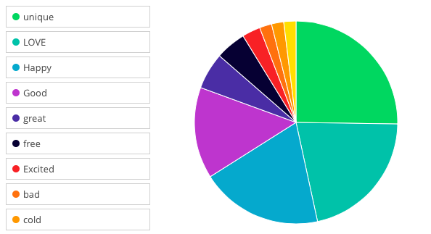
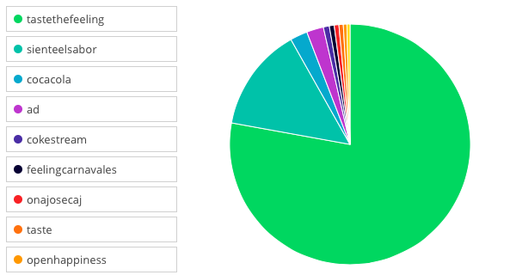
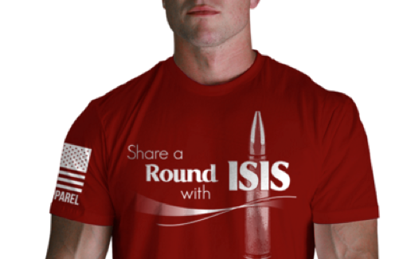
Report 2-1-2016
Campaign Topics & Link Overview
H | Feelings
I | Hashtags
More than 95% of feelings associated with the campaign were positive. “Bad” was the first negative feeling with 2%
The hashtags were positive and relatively predictable. Fortunately, the opposition to the campaign was not clever enough to link their efforts to a hashtag
J | Links
#1 Share Happiness Link
http://nine.li/1OxbCBc
#1 Media Link
http://adage.com/article/cmo-strategy/coke-debuts-taste-feeling-campaign-strategic-shift/302184/
#1 Advocate Link
http://push.abs-cbn.com/albums/3528/kapamilya-stars-at-the-coca-cola-taste-the-feeling-media-event/
#1 GIF creator Domain
spr.ly
The most surprising link was one associated with “Share a Coke” that used Coke’s likeness in association with the terrorist group, ISIS.

